Slide 1
Creation vs evolution part 1
Essentials Doctrine
Ref: John 1:1-3 (amp) – “All things were made through Him”

Slide 2
2. Creation vs evolution
God created the laws of physics, biology, chemistry, etc. so it makes sense that science agrees with the bible.
Science has yet to catch up to God and science shows evidence of God and creation
Why does creation or evolution matter?
If creation is true, then we have purpose and a reason for being
If evolution is true, then we are just another step in the process, random, and valueless
Ref: - Isaaiah 40:22 (amp) “sits above the circle of the earth”
Ref: - Hebs 1:1-3 (amp) – “upholding & maintaining”

Slide 3
3. Evolution
Evolution is a theory (or religion)
It begins with the big bang (a giant vacuum when two particles collided, causing a release of energy that created all of the universe)
Over billions of years, through many more random collisions of particles in randomly the right conditions and environments, life was formed
Over billions more years, a single cell then become complex organisms, eventually creating us, human beings
Question # 1: - As long as I believe in the bible, why should I care about the creation-evolution issue?
https://creationministries.org/frequently-asked-questions-about-creation/#

Slide 4
4. Creation
Creation is a belief
Creation begins with a belief in God and that He created everything
God created the universe, the earth, life on our planet, and human beings, all within 6 days, and on the 7th day, He rested.
Creation means that God created man in His own image, unique from every other animal
Ref: - Gen 1:27 “So God created man in His own image” (nkjv)
Ref: - Mat 19:4-6 (amp) “made them male and female”

Slide 5
5. Scientific evidence?
Most discovered fossils are incomplete
Much is assumed in the recreation of fossils and in extrapolating features of fossils
We take the standpoint that the bible is truth. The bible is not a scientific book, but it is scientifically accurate.
Creation was a one time miracle (i.e. we will not find another earth somewhere)
Question # 2: - Why do biblical creationists fight science?
https://creationministries.org/frequently-asked-questions-about-creation/#

Slide 6
6. Noah’s Ark
People dispute Noah’s ark because it is a simple and easy story, yet unbelievable in it’s scope
People struggle to accept that something like that could have happened without any evidence
All the answers are actually given to us by the bible, the facts are not assumed
Video # 1: -
https://www.youtube.com/watch?v=-KcC0BHd9jI

Slide 7
7. authenticate from the scriptures
Moses – Ref Gen 6-9;
Jesus - Ref Matt 24:37, 38
Noah - Ref Hebs 11:7
Peter - Ref I Pet 3 & 2
Preacher - Ref 2 Pet 2:5
Activity # 1 - Kahoot

Slide 8
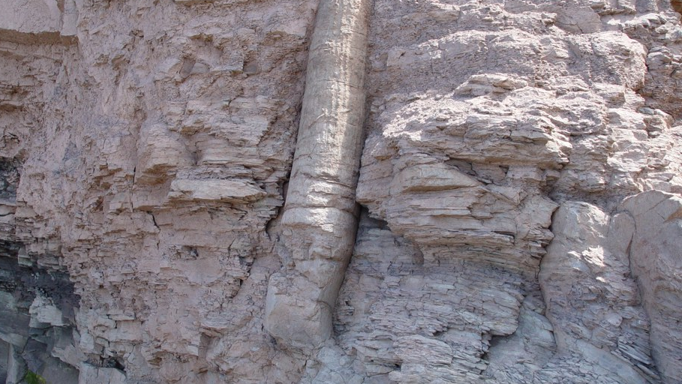
8. Polystrate fossils

Slide 9
9. THE fossils THEMSELVES
Layers of strata are said to form over millions of years
Yet we find polystrate fossils – where a single fossil crosses many layers of sediment
A flood would cause a single fossil to be stuck amongst many layers of sedimentation (strata)

Slide 10
10. Spontaneous sorting of layers

Slide 11
11. Spontaneous sorting of layers
Sediments settle in clearly defined layers when in water
Outside of this environment, layers should not form uniformly, yet we see ‘pancake’ layered strata that extends over great distances (thousands of square miles)
Evolutionists believe that they would take millions of years, but there is no evidence of erosion and because of the extensive size of the layers. Layers that go that broad must have settled at the same time.

Slide 12
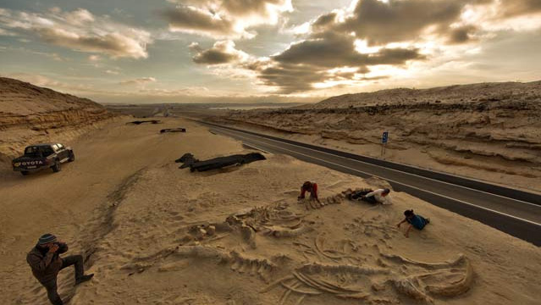
12. Whale fossils

Slide 13
13. Whale fossils
Whale fossils were found next to the Pan-American Highway in Chile, in the desert
A mass grave with many whales and dolphins in the same area, different species
Scientists claim that it is the cause of toxic algae (with nothing to support this claim)

Slide 14
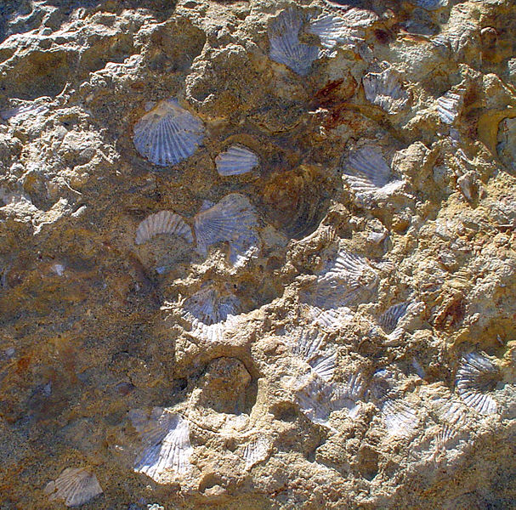
14. Marine fossils in mountains

Slide 15
15. Marine fossils in mountains
Mountains around the world contain sea shells and marine fossils
Mountains include the Sierras, the Swiss Alps, the Himalayas, and more
Video # 2: -
https://creation.com/m/marine-fossils-on-mount-everest
Global flood would explain how they got there (Read Ps 104:6-9 (amp))

Slide 16
16. online References
CREATION
https://creation.com
https://answersingenesis.org
https://creationministries.org/frequently-asked-questions-about-creation/
FACTS ON NOAH'S ARK
http://www.ldolphin.org/cisflood.html
RESOURCES FOR KIDS
https://answersingenesis.org/kids/

